Slide 1
SE WY Estate Planning
CRMC | Talent Acquisition

Slide 2
Introductions
Christian Guenther
Karen Marshall
Tara Rood
Notes:
Courtney Strole

Slide 3
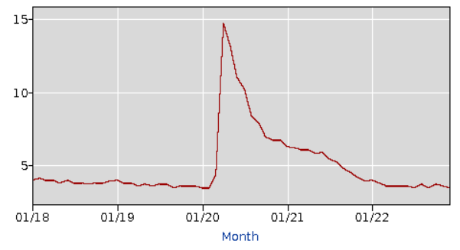
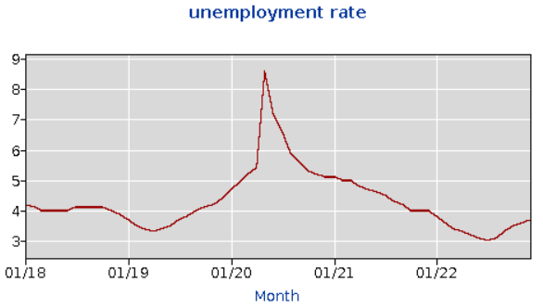
Job Market Statistics
National unemployment rate peaked at 14.7% in April 2020 (Covid) and has been slowly recovering since
Q4 2022: 3.6%
Q3 2022: 3.57%
Q2 2022: 3.6%
Q1 2022: 3.8%
Wyoming unemployment rate peaked at 8.6% in May 2020 (Covid) and has been slowly recovering since, with a slight increase at end of 2022
Q4 2022: 3.55% (w/o December)
Q3 2022: 3.13%
Q2 2022: 3.2%
Q1 2022: 3.43%
National Unemployment Rate
Wyoming Unemployment Rate
Notes:
https://data.bls.gov/timeseries/LASST560000000000004?amp%253bdata_tool=XGtable&output_view=data&include_graphs=true

Slide 4
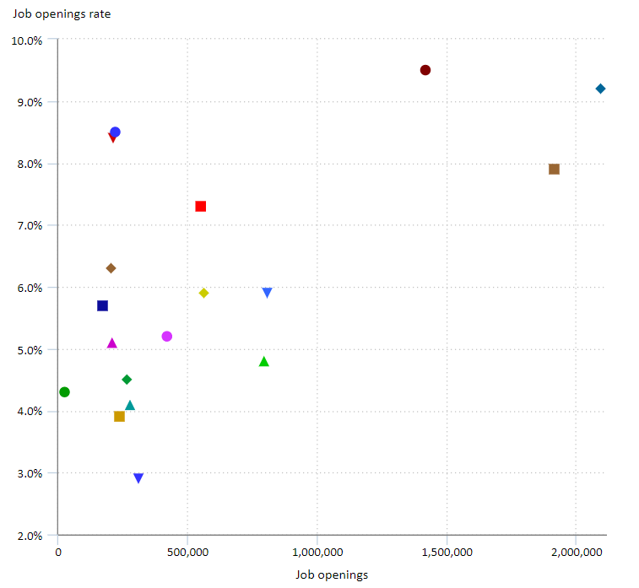
Job Market Statistics
On the last business day of September 2022, the overall job openings rate was 6.5 percent
There were 2.1 million job openings in health care and social assistance, yielding a job openings rate of 9.2 percent
Notes:
The job openings rate is computed by dividing the number of job openings by the sum of employment and job openings and multiplying that quotient by 100.
https://www.bls.gov/opub/ted/2022/2-1-million-job-openings-in-health-care-and-social-assistance-in-september-2022.htm
https://www.census.gov/library/stories/2021/04/who-are-our-health-care-workers.html

Slide 5
The Great Divide
While the unemployment rate has steadily declined since the mid 2020. People are only considered ‘unemployed’ if they are actively seeking work. (Those who have given up on finding a job or are not looking for work are no longer considered part of the labor force—and therefore not counted among the unemployed).
The labor force participation rate is a better metric for assessing the health of the labor market and the size of the active workforce. The labor force participation rate was 62.4% in August 2022, whereas in February 2020, pre-pandemic, the labor force participation stood at 63.4%.
Notes:
The Great Divide BETWEEN JOB SEEKERS AND EMPLOYERS
Express Employment Professionals
Covid is certainly a watershed moment in history, many believe that things will not go back to the way they were before, in order for workplaces to survive and even thrive into the future, leadership must recognize this and move quickly to provide workers with the things they seek and prioritize actions that bring value to employees

Slide 6
10 Barriers to Employment in the Current Economy
• Childcare
• Elder care
• Unpredictable business needs
• Job training and skills
• Work history and criminal history
• Transportation and geography
• Health issues and concerns
• Communication issues
• Workplace culture expectations
• Wage expectations
Notes:
Express
Where can employers assist with these barriers? I.e. remote work may help with transportation/geography barriers; flex schedules may help with health issues or concerns and elder care and child care obligations

Slide 7
The Great Resignation - Causes
Bad Culture
No Flexibility
Poor Management
Too Few Opportunities for Advancement
Poor Health & Safety Regulations Around Covid

Slide 8
The Stats
73% of workers want remote work to stay
54% are tired of feeling Burnt Out
39% want to be their authentic selves at work
40% of the global workforce is ready to Quit
Industries feeling it the most: Retail/Hospitality/Leisure & Travel/Manufacturing/Technology/Healthcare
Notes:
2021 Microsoft Work Index

Slide 9
Employment Trends in 2023
Indeed & Glassdoor recently released their 2023 Hiring and Workplace Trends report, with 5 major trends
Tight Labor Supply Will Continue to Impact Hiring
Remote Work Is Here to Stay
As Workers Seek Higher Pay, Benefits Can Set Employers Apart
Happiness and Wellbeing Matter
The Changing Workforces Is Pushing Diversity, Equity, and Inclusion to the Forefront
Notes:
Internal mobility
Remote work eliminates
the commute, which has allowed workers
with disabilities to find and maintain
employment. In addition, remote work has the
potential to create much more diversity in the
workforce. Remote work at this scale is new
territory for employers, and it is imperative
they continue to monitor and adjust their
policies to ensure the inclusivity,
Compensation remains king for job seekers.
Among employed US workers ages 25-54,
higher pay was the most often selected reason
they searched for a new job. This is true for all
industries, including those working for hourly
wages. In spring 2021, the share of searches for
$20 wages surpassed those for $15 and as of
August 2022 has grown 35.5% year over year.
Widespread wage gains and inflation are likely
both influencing job seekers’ expectations
toward higher dollar amounts.
Perhaps the most critical benefit that seems to
be growing across all industries is mental health
care. Soon after the start of COVID in the US, an
upward shift occurred in the share of employee
benefit reviews on Glassdoor that say that their
employer offers mental health benefits. This
trend steadily increased throughout 2022.
Stress is leading to turnover,. After pay considerations, stress, lack of satisfaction and happiness are the leading reasons people look for new opportunities

Slide 10
Employment Trends in 2023
Tight Labor Supply Will Continue to Impact Hiring
As impacts from COVID-19 begin to recede, hiring difficulties will not disappear
Candidates across all industries will remain highly sought after
Remote Work Is Here to Stay
When COVID made remote work a necessity, many employers discovered that it worked well
Employee’s see it as a benefit and will seek positions that offer remote/hybrid options
Notes:
Source: Indeed & Glassdoor Hiring & Workplace Trends Report 2023

Slide 11
Employment Trends in 2023
As Workers Seek Higher Pay, Benefits Can Set Employers Apart
Compensation remains the most often selected reason most workers search for a new job, but job seekers are also paying more attention to benefits
Companies can offer unique, relatively low-cost benefit options to set themselves apart from competitors
First two weeks paid as rest/recharge period
Fitness stipends
Continuing education stipend
Flexible work hours
Childcare stipend
Personal interest allowance
Birthday PTO
Family leave
Notes:
Source: Indeed & Glassdoor Hiring & Workplace Trends Report 2023

Slide 12
Employment Trends in 2023
Happiness and Wellbeing Matter
Creating a positive company culture can distinguish your business as an employer of choice for job seekers
With more employers searching for candidates, workers are demanding greater wellbeing in their work experience
Increased levels of happiness
Job satisfaction and purpose
Manageable stress
The Changing Workforce is Pushing Diversity, Equity, and Inclusion to the Forefront
Younger workers are demanding more from employers when it comes to social justice
“72% of workers aged 18-34 said they would consider turning down a job offer or leaving a company if they did not think that their manager supported DEI initiatives”
How can you emphasize DEI in your business or on your team?
Notes:
Source: Indeed & Glassdoor Hiring & Workplace Trends Report 2023

Slide 13
Other Key Takeaways
Act Fast!
Stop Looking For the ‘Perfect’ Candidate
Focus on soft skills, eagerness to learn, and give someone an opportunity to prove themselves
Look for Internal Interest
Notes:
Source: Indeed & Glassdoor Hiring & Workplace Trends Report 2023
Fixing the great resignation: employers need to be open to flexible work options, and understanding why people are discontent and what can be done to make them want to stay long term
The State of Discontent: What’s Really Behind the Great Resignation - NeuroLeadership Institute
A toxic corporate culture is by far the strongest predictor of industry-adjusted attrition and is 10 times more important than compensation in predicting turnover. – Donald Sull, Charles Sull, Ben Zweig ‘Toxic culture is driving the great resignation’

Slide 14
What Job Seekers Want
Boosted Benefits
Hybrid and Remote work options/Four-day work weeks/flexible schedules
Career Growth Opportunities
Salary Transparency
Diversity and Inclusion
Wellness programs
Notes:
Despite looming talks of recession, workers continue to press for higher pay, stronger benefits, scheduling flexibility and a variety of other prerequisites. Needless to say, a lot is in store when it comes to workplace trends in 2023. https://thehill.com/business-a-lobbying/business-lobbying/3793595-5-top-trends-for-jobseekers-to-know-about-in-2023/

Slide 15
Boosted Benefits
Learning and development opportunities
Wellbeing offerings
Internal job rotation
Childcare program
Freebies: Foosball, food/snacks/beverages, massages
Employee of the month awards
Opportunities instead of prizes: trips to trade conferences and conventions, desirable assignments
Notes:
Look beyond benefits packages to enhance perks
Think outside the box when it comes to compensation and incentives
Google offers: Free haircuts, dry cleaning, gyms, swimming pools, trainers, nap pods, subsidized massages, onsite doctors
Childcare – 20-30% of income goes towards childcare

Slide 16
Hybrid and Remote work options/Four-day work weeks/flexible schedules
Hybrid and remote work is here to stay*
Provide more balance between work and personal life
Flextime: adjusting starting/ending times, “Summer Fridays”
Compressed workweek: (4-10s), (9/80),
Shift work
Part-time schedules
Job sharing
Notes:
Hybrid and remote work is here to stay
Provide more balance between work and personal life ‘pay pal’ does this well
Four day work weeks
“shorter work weeks are a surefire way to offer employees a better work-life balance, as well as a tool to compete against companies with more lucrative compensation packages” “Four-day week trials have taken place in many countries in recent years including the UK, Ireland, Belgium, Sweden and Iceland, and 2023 will see projects starting here in the US as well as Scotland, Canada and New Zealand”
https://www.shrm.org/resourcesandtools/tools-and-samples/toolkits/pages/managingflexibleworkarrangements.aspx
*Now that many employers have experienced how successful telecommuting can be for their organization or how work hours that differ from the normal 9-to-5 can be adopted without injury to productivity, offering flexible work arrangements have become more commonplace.
*Even in the absence of a pandemic, flexible work arrangements can improve recruitment and retention efforts, augment organizational diversity efforts, encourage ethical behavior, and help the organization's efforts to be socially responsible. Employers can experience cost savings, improved attendance and productivity, and an increase in employee engagement.
FLEXTIME
Flextime is a type of alternative schedule that gives a worker greater latitude in choosing his or her particular hours of work, or freedom to change work schedules from one week to the next depending on the employee's personal needs. Under a flextime arrangement, an employee might be required to work a standard number of core hours within a specified period, allowing the employee greater flexibility in starting and ending times. See How to Create and Manage an Effective Flexwork Policy.
COMPRESSED WORKWEEK
Compressed workweek is an alternative scheduling method that allows employees to work a standard workweek of 40 hours over a period of fewer than five days in one week or 10 days in two weeks. For example, some employers implement a four-day workweek of 10-hour days. Employers get the same number of working hours, but employees have a three-day weekend every week. Another approach is the 9/80 schedule, in which employees work 80 hours in nine days and have one day off every other week. Among other demographics, employees whose family status involves child care or elder care responsibilities may find a compressed workweek to be of particular value. Employees save time and commuting expenses by reporting for duty on fewer days. Employers that convert their entire operation to a four-day workweek may save on the cost of utilities and other overhead. See 5 Steps for Adopting a Four-Day Workweek.
SHIFT WORK
Shift work has traditionally been used in manufacturing environments to maximize productivity from fixed resources and costs. More recently, shift work has become a feature of the 24/7 service economy and a byproduct of globalization. For example, supermarkets and computer help desks are now typically open 24 hours a day, seven days a week. Nowadays, a computer user calling for technical support during regular U.S. business hours is likely to end up speaking with a technician working the "graveyard shift" in India. Despite its extensive use in certain environments, shift work poses some practical challenges for some employers. Employers are encouraged to provide schedules that are as predictable as business needs permit.
PART-TIME JOBS
Part-time jobs are the most traditional of flexible scheduling options. This option is typically used when a job requires fewer than 40 hours of work per week. Part-time work can be used to attract a workforce that includes students, parents of young children, older workers, and others who need or want to work but do not wish to work a full-time schedule. Although more commonly associated with jobs in retail and food service, some employers do have part-time professional employees. Part-time work can help organizations retain professionals who otherwise would be lost.
JOB SHARING
Job sharing is the practice of having two different employees performing the tasks of one full-time position. Each of the job-sharing partners works a part-time schedule, but together they are accountable for the duties of one full-time position. Typically, they divide the responsibilities in a manner that meets both of their needs as well as those of the employer. The practice allows for part-time schedules in positions that the employer would not otherwise offer on a part-time basis. It requires a high degree of compatibility, communication and cooperation between the job-sharing partners and with their supervisor.
Like part-time jobs, job-sharing arrangements may appeal particularly to students, parents of young children and employees nearing retirement, helping them balance careers with other needs. For employers, the practice may include retention of skilled employees, increased employee loyalty and productivity, and a measure of flexibility that can occur when two people fill one job slot.
Leads to increased worker happiness and higher productivity “It’s not so much that everyone wants to work from home, but having the flexibility to shape their work around their lives is seen as essential for today’s workforce”

Slide 17
Career Growth Opportunities
One of the biggest factors in worker satisfaction is the ability to gain new skills and knowledge.
This new and/or enhanced expertise can lead to enticing career opportunities for employees.
Employee retention rates tend to rise for companies that prioritize internal talent development.
Notes:
clearly defined career paths [hiring managers should build a ‘roadmap’ for each ee to help them get to their desired ‘destination’ with ‘landmark’ stops along the way, gain new skills and knowledge, “Employee retention rates tend to rise for companies that prioritize internal talent development.” Recognizing the Value of Internal Talent Development - Lever
“tracking and tapping into workers’ skill sets, proficiencies, and interests alleviates pressure on TA.”

Slide 18
Career Pathways

Slide 19
Salary Transparency
Whether required by law or not, pay transparency can be a key tool in closing gender and racial pay gaps
Include pay range with job descriptions
Required by law in Colorado with states like New York, California and Washington working on passing similar laws
Notes:
the recent rise in pay transparency legislation is part of a long-term wave of pressure to enhance transparency––and therefore fairness––in the job market. This trend has been accelerated by technology, and especially by salary sharing websites like Glassdoor, which pool information from workers across industries, geographics and seniority levels”
Washington, D.C. has one of the largest gender pay gaps in the country, following only Wyoming and Utah - Pay transparency is trending for all the right reasons | The Hill

Slide 20
Diversity and Inclusion
According to Glassdoor, two out of every three job seekers specifically look for companies with diverse workforces during their search
Research has long shown that a company’s bottom line benefits from the inclusion of a diverse workforce
Being open to remote work options can help with Diversity and Inclusion efforts – opens up a wider candidate pool than otherwise may have
Notes:
Diversity, equity, inclusion and belonging (DEIB) initiatives and values will be a critical component for companies that want to keep up a productive and positive workplace in 2023” “According to Glassdoor, two out of every three job seekers specifically look for companies with diverse workforces during their search. And research has long shown that a company’s bottom line benefits from the inclusion of a diverse workforce” “It can be challenging to figure out which companies are truly committed, but you can get a better feel for culture by reading company reviews (on sites like Glassdoor and indeed.com) or visiting the company website and social media postings.”

Slide 21
Wellness programs
Job seekers are looking for companies that have a healthy environment and a positive culture
Showing investment in employees by offering a solid health and wellness program with visible results and rewards will be an added perk job seekers will take note of
Remember the holistic approach to wellness and include not only physical health but mental and financial as well

Slide 22
Job Advertising Strategies
Build out Social Media pages
Before even applying candidates will look at multiple sources of your social media sites to get an idea of your culture, the type of people they would work with, what you do for the community, etc.
It’s important to build these pages out so they will see the most accurate representation of your business
Sourcing!!

Slide 23
Sourcing – How do we do this?
What is sourcing?
Proactively finding, engaging, and hiring candidates that you think would be good for a role
We source on LinkedIn, Indeed, and ZipRecruiter
Search by certain criteria (job title, location, years of experience, licenses/certifications, etc.)
Create template for sourcing
Short and to the point
Brief info on the role, any benefits that may stand out, call to action
Most candidates view these messages on their phone, so you want to make sure the messages are short so you don’t lose their attention
We tend to first start with candidates who have been the most recently active on that site
Each site has a way to see who has been recently active
These candidates tend to be the ones who are actively looking for a new job, updating their resume, etc.

Slide 24
Sourcing – What do we look for?
Someone who has:
All required qualifications
Recently active on the site
Has most of our preferred qualifications
A plus: If they are “Open to work” on LinkedIn
Sourcing is all about the numbers! The more messages you send, the more responses you will get back!

Slide 25
Facebook
Have the most up to date information on your business account
Hours, location, contact information
Create posts, ads, and stories to attract people to your page
2-3 posts per week
Feature company culture
Highlight employees, post about benefits, highlight current openings
Ads for hard to fill positions, any events coming up, etc.
These are different than posts as they will not show up on your main business page

Slide 26
Indeed
Build up employer page
-Include information on why people should work there, feature benefits, etc.
Focus on getting positive reviews from current/past employees
Sponsor hard to fill positions
-This will have your jobs towards the top of candidate searches
Source candidates

Slide 27
LinkedIn
Post hard to fill positions
Source candidates
Post to company page
Company updates, employee spotlights, current openings
Similar to Facebook posts
Some positions work better on LinkedIn than on Indeed so allocate money accordingly
We have noticed more of our “business/non-clinical” roles tend to do better on LinkedIn, especially roles in management

Slide 28
Glassdoor
Build up employer page
-Include information on why people should work there, feature benefits, provide company updates, etc.
Focus on getting positive reviews from current/past employees
Scrapes jobs from careers page
-Employees who rate their companies 2 stars (1-5 scale) are twice as likely to begin an application to a new job on Glassdoor than those who rate their companies 5 stars.
-A 1-star increase in Glassdoor rating is associated with a 6% drop in the likelihood that they begin an application for a new job
Notes:
Scrapes jobs to site

Slide 29
ZipRecruiter
Sponsor jobs for higher visibility
Source resumes and send messages to candidates
If they’re not searching for jobs on LinkedIn or Indeed, they are most likely on ZipRecruiter
Candidates can “Quick Apply”
This allows them to express interest in a role without filling out an application
Can also do this with Indeed and LinkedIn
Notes:
“If they’re not searching on Indeed and LinkedIn, then they’re searching on ZipRecruiter” - Tara to send stat if possible

Slide 30
How do we determine our budget?
The Average cost per hire on job boards is typically $150-$200 per hire.
Your recruiting budget depends on a few factors:
How many openings do you have? (The more openings you have the more you will need to spend)
How difficult do you expect recruiting for the position will be? ( The more money you spend the more impressions the job will get on job boards due to it staying at the top of the job board search results)
Do you typically have high turnover in this position? If yes, then you will need to have this position posted more regularly thus you will need more budget for it.
Once you have answers to those questions you can then sit down and decide how much you need to spend on sponsorship dollars on Indeed and other job boards
A good rule of thumb is to spend no less than $20 per day on indeed quick apply postings – this will keep your job at the top of the search results.

Slide 31
Employment Branding – What is it and how do you do it?
An Employer Brand is essentially what the organization communicates as its identity to both potential and current employees
It is all about selling your company
-What can you offer that your competitors can’t?
-What makes you stand out?
Notes:
https://www.shrm.org/resourcesandtools/tools-and-samples/hr-qa/pages/cms_023007.aspx

Slide 32
How to Build/Improve Job Postings
Give information about the company
How the company started, values, mission statement, etc.
Include why someone should work there
What stands out about your company?
Benefits, pay, sign on bonuses?
Always have this information as close to the top of the posting as possible – this is what will intrigue candidates to apply
Notes:
https://gtm.com/business/improve-your-job-postings/

Slide 33
Questions?

